Slide 1
GPU Sharing in Serverless Computing
Tao Li, Zhuoyuan Li, Chuanyi Liu
[1] FaST-GShare: Enabling Efficient Spatio-Temporal GPU Sharing in Serverless Computing for Deep Learning Inference. ICPP’23
[2] Transparent GPU Sharing in Container Clouds for Deep Learning Workloads. NSDI’23
[3] GSLICE: Controlled Spatial Sharing of GPUs for a Scalable Inference Platform. SoCC’20
[4] KubeShare: A Framework to Manage GPUs as First-Class and Shared Resources in Container Cloud HPDC’20
[5] Gemini: Enabling Multi-Tenant GPU Sharing Based on Kernel Burst Estimation TCC’23
Notes:
1. 我们现在考虑的场景是云上多模型多租户的大模型推理，我们认为GPU sharing是支持这种场景的关键技术，我们之前也讲了一些GPU sharing的技术，因为我们想基于Serverless computing的云环境去做，因此我们最近看了些在容器云上优化GPU sharing的一些工作，今天给两位老师进行一下汇报，结合上次老师们建议我们这次的内容会多一些如何使用GPU等系统实现上的内容。

Slide 2
Outline
Current Progress
FaST-GShare^{[1]}
MuxServe^{[2]}
Conclusion
[1] FaST-GShare: Enabling Efficient Spatio-Temporal GPU Sharing in Serverless Computing for Deep Learning Inference. ICPP’23
[2] MuxServe: Flexible Spatial-Temporal Multiplexing for Multiple LLM Serving. ICML’24

Slide 3
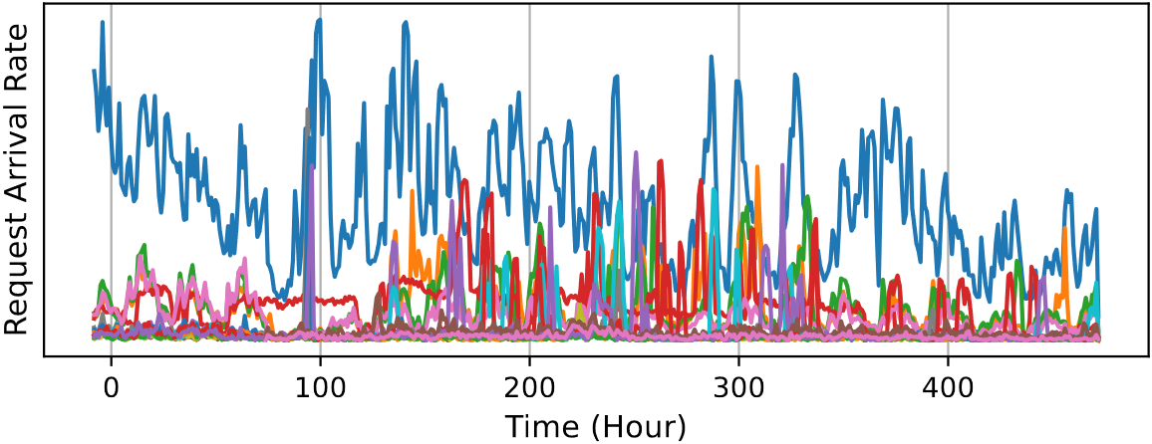
Motivation
Multiple LLMs serving^{[1,2,3,4,5]}
Bursty workloads: real traffic observed by ShangHai AI Lab in 20 days
An example：2 different models deployed on 4 nodes
Bursty Workloads
Low Utilization
Node1
Node3
Node1
Node3
_{Cold Model}
A₁
B₁
Improve
Utilization
A₁
B₁
B₄
A₄
Pipeline
_{Hot Model}
Node2
Node4
Node2
Node4
A₂
B₂
A₂
B₂
B₃
A₃
Deployment 1
Deployment 2
[1] MuxServe: Flexible Spatial-Temporal Multiplexing for Multiple LLM Serving. ICML’24
[2] ServerlessLLM: Low-Latency Serverless Inference for Large Language Models. OSDI’24
[3] dLoRA: Dynamically Orchestrating Requests and Adapters for LoRA LLM Serving. OSDI’24
[4] AlpaServe: Statistical Multiplexing with Model Parallelism for Deep Learning Serving. OSDI’23
[5] PetS: A unified framework for Parameter-Efficient transformers serving. ATC’22
Notes:
TODO: multi-tenant与multi-model的区别？

Slide 4
Motivation
Why Serverless Inference for LLMs?
Easy to use
High elasticity
Fine-grained billing
[1] ServerlessLLM: Low-Latency Serverless Inference for Large Language Models. OSDI’24

Slide 5
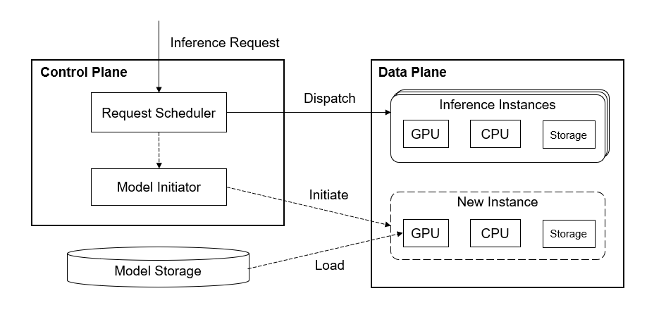
Motivation
Serverless inference paradigm
Control plane --- request dispatching
Data plane --- inference computation

Slide 6
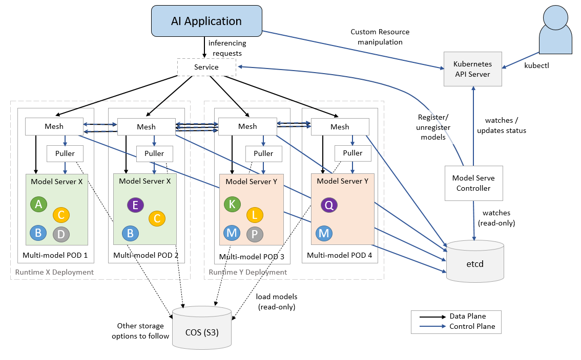
Motivation
Kserve: container management overhead
‘One model, one pod’ paradigm harms scalability
Adopt multi-model pods and container mesh to orchestrate model placement
[1] KServe: https://github.com/kserve/kserve
Notes:
初始做法：一个pod/容器内只服务一个模型，边车容器和附加网格管理的均摊开销巨大（1 sidecar per model）
Kserve：创建multi-model pod，减小scaling开销（1/n sidecar per model）；

Slide 7
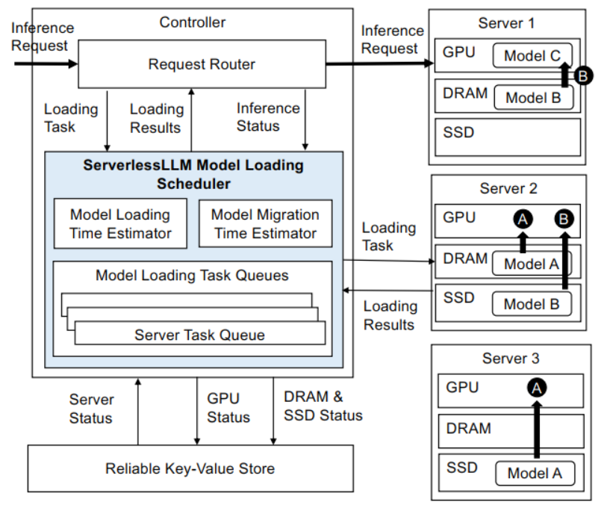
Motivation
ServerlessLLM: data loading overhead
Downloading and loading LLM checkpoint from storage incur a lengthy process
Utilize multi-tier storage in GPU server to accelerate download and load
[1] ServerlessLLM: Low-Latency Serverless Inference for Large Language Models. OSDI’24

Slide 8
Motivation
An experiment on existing systems (TODO)
Model LLaMA; Workload ShareGPT
Measure compute and memory occupations(%)
Expectation: under-utilization of GPU resources

Slide 9
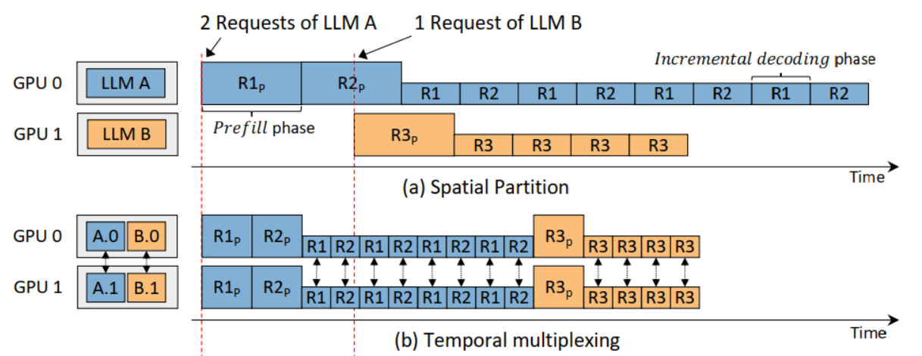
Motivation
Limitation of existing systems
Severe resource under-utilization in LLM inferences
Assigns integral GPU devices to a single container by default
With MPS or GPU slicing, KServe still ignores the inconsistent resource requirement
Consider ***
改成单GPU
Notes:
serverless

Slide 10
Design: Fine-graind GPU Sharing
Take consideration of time-
Mitigate the fragmentation of GPU resource
Lower the cost of inference service

Slide 11
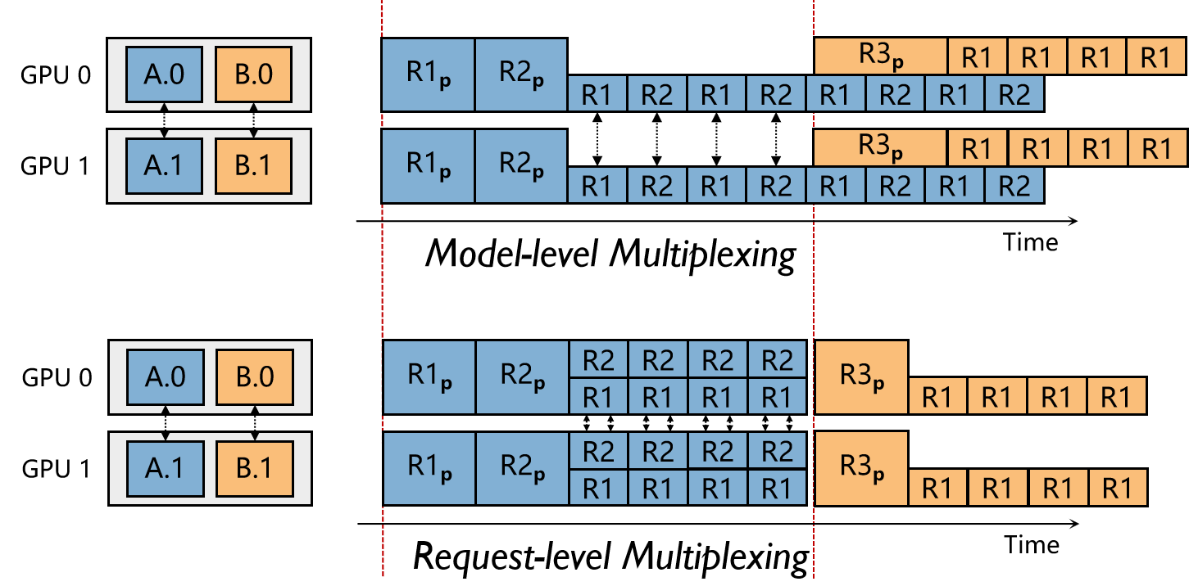
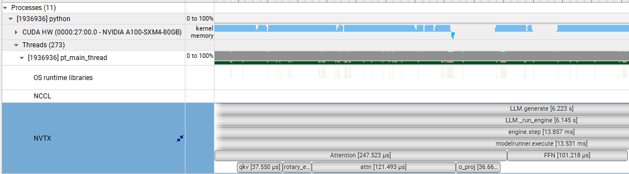
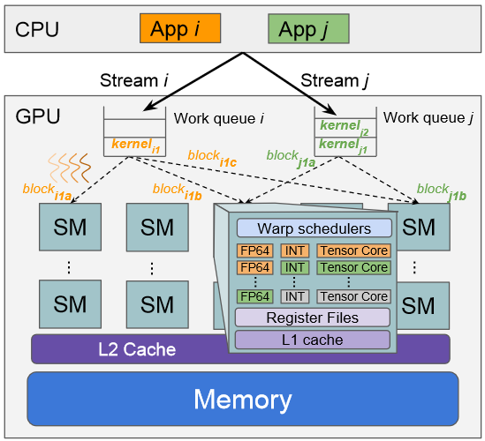
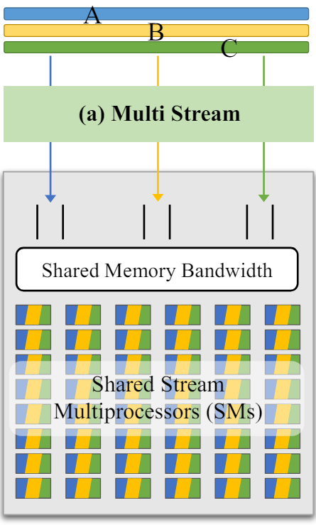
Main Idea: Fine-graind GPU Sharing
Request-level GPU sharing
Technique：MPS
Challenges
Trade-off between SLO and
resource utilization
Communication overhead
Kernel-level GPU sharing
Technique：CUDA streams
Challenges
The number of CUDA
streams
Improve
resource
utilization

Slide 12
Challenges
Maintain SLO attainment
Implement resource reallocation efficiently
Run the framework transparently to user

Slide 13
Challenge
How to schedule to meet SLO at best efforts?

Slide 14
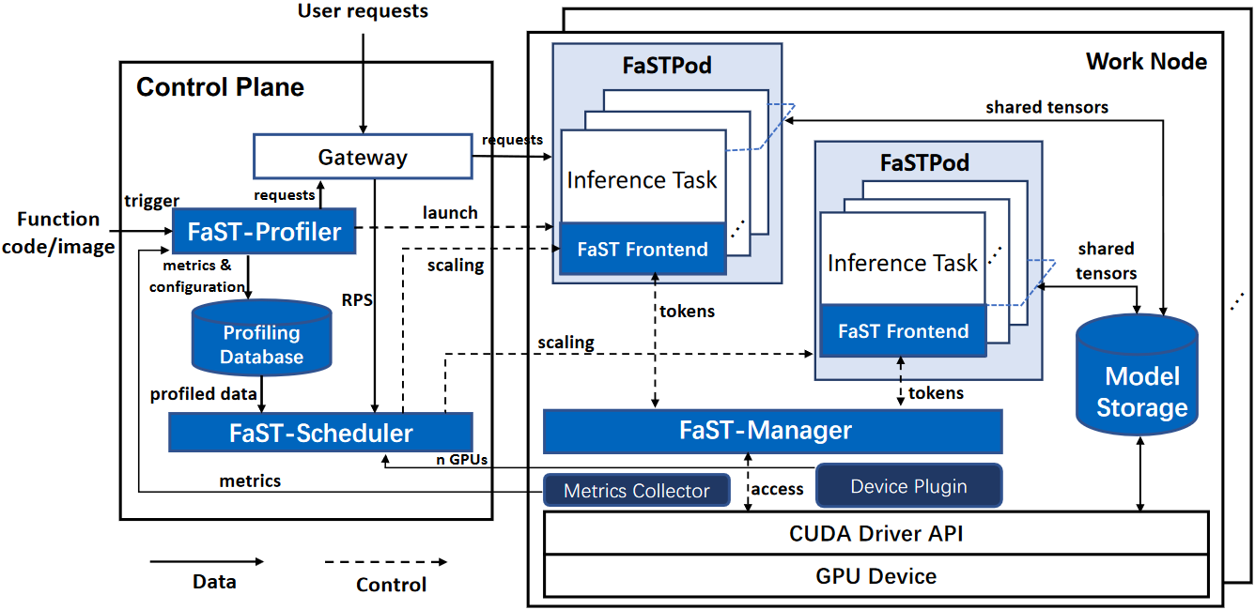
Challenges
How to design an efficient serverless LLM serving framework?
What are the key components needed for a complete workflow?
Profiler
Scheduler
GPU Manager
Computing resource
Memory resource

Slide 15
Outline
Current Progress
FaST-GShare
Background
Architecture
MuxServe
Conclusion

Slide 16
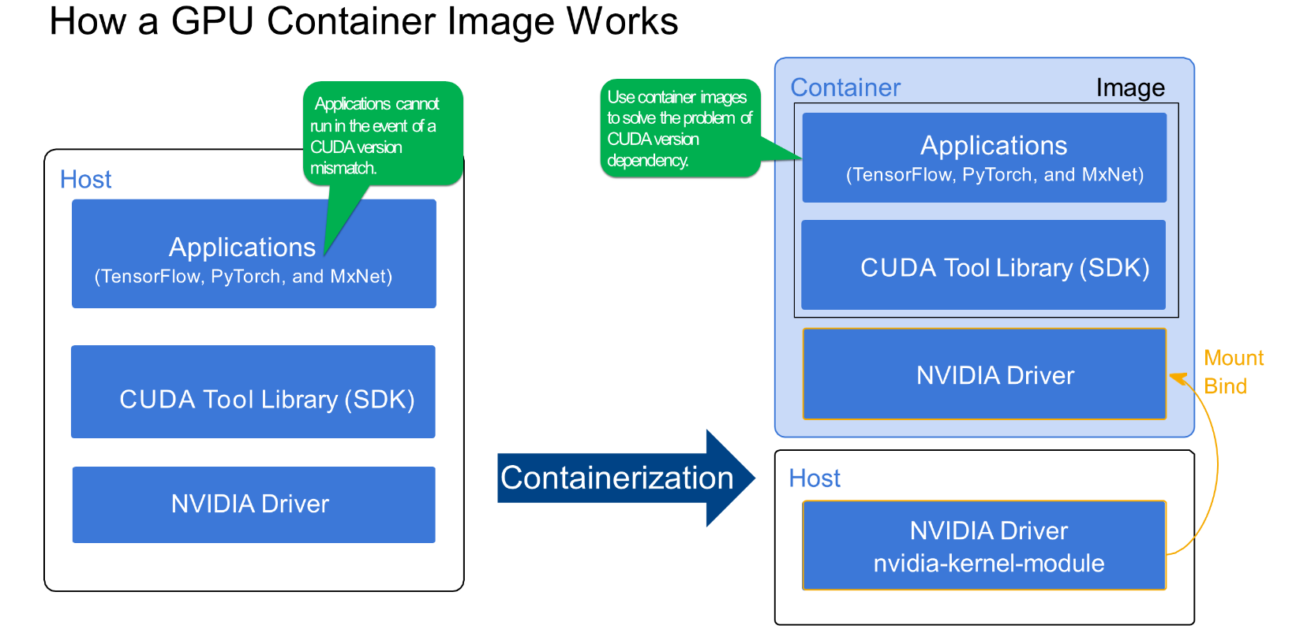
GPU Support in Serverless Computing
Commercial serverless platform
Amazon Lambda, Microsoft Azure Functions, and Google Cloud Functions
Only allow CPU access currently
Don’t natively support accelerators, such as GPUs and TPUs
Open-source serverless platform
OpenFaaS, Knative, and OpenWhisk
Leverage Kubernetes to deploy and manage functions
Get the device path
Mount the driver directory
Notes:
1. 主机环境下部署GPU应用，软件栈包含三个层次 ML框架、CUDA lib和NVIDIA驱动

Slide 17
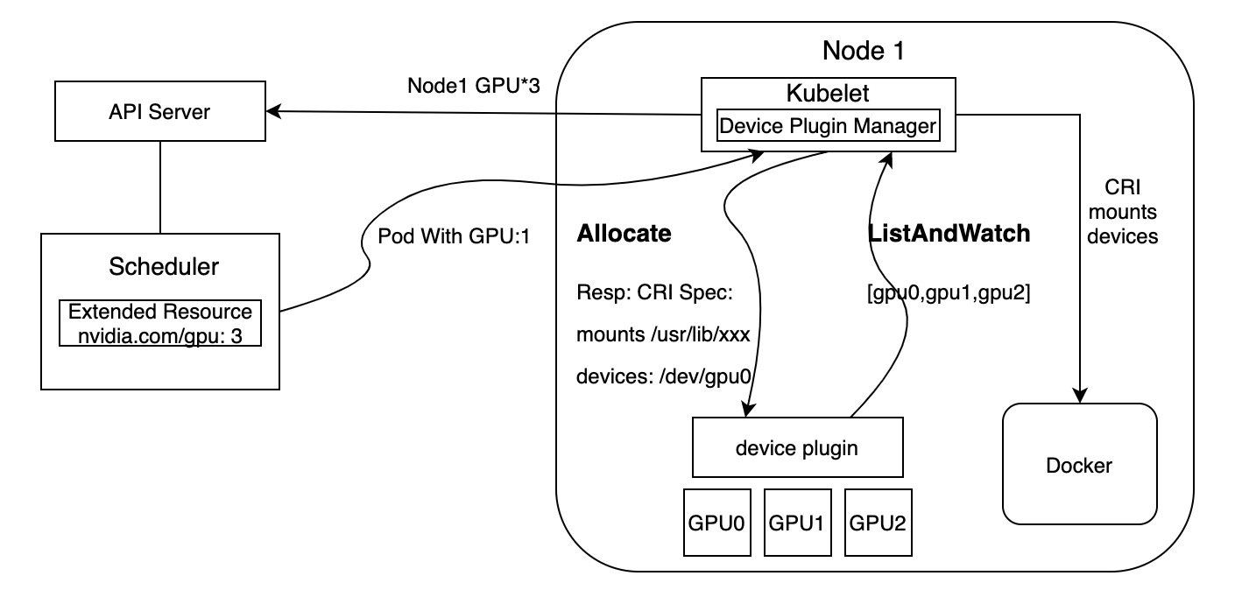
GPU Support in Serverless Computing
Open-source serverless platform
The GPU device plugin
communicates with the NVIDIA device driver to discover and report the available GPUs on a node.
handles device assignment and lifecycle management for GPU workloads
Limitation：
Assign an entire GPU device to a single container
Severe resource under-utilization in deep learning inferences

Slide 18
Outline
Current Progress
FaST-GShare
Background
Architecture
MuxServe
Conclusion

Slide 19
Architecture Overview
FaST-Profiler
Profile the function throughput and latency under various spatio-temporal GPU resource
FaST-Scheduler
Select resource config, perform the auto-scaling and node selection for function
FaST-Manager
Coordinate the spatial and temporal GPU resource sharing by limiting and isolating resources
Model Sharing
Propose the IPC-based model sharing to mitigate memory contention among functions

Slide 20
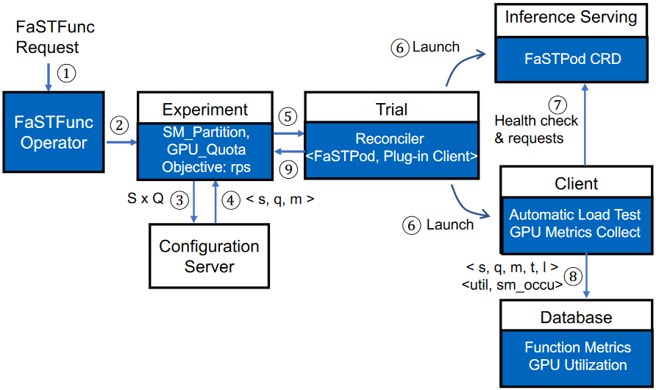
FaST-Profiler
Profile the function throughput
Under various spatio-temporal GPU resource allocations
Experiment-Trial workflow
Experiment phase：configure resources and initiate a profiling Trial
Trial phase：generate the test workload and perform inference tasks

Slide 21
FaST-Scheduler
Scale and schedule functions across nodes
Efficiently utilize GPU under the spatio-temporal sharing mechanism
Ensure function SLOs
Heuristic auto-scaling
Scale functions dynamically to adapt to traffic changes to meet SLOs
Node selection
Schedule function pods to enhance GPU resource efficiency and mitigate resource fragmentation

Slide 22
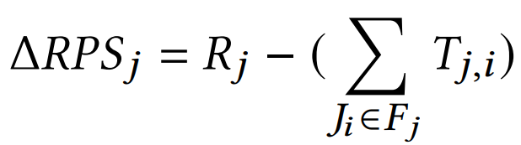
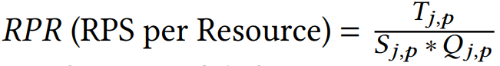
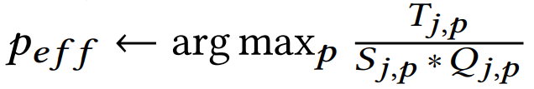
FaST-Scheduler
Heuristic auto-scaling
Scale functions dynamically to adapt to traffic changes to meet SLOs
Determine whether to scale-up or scale-down
R：request loads
T：request processing capabilities
Select effective configurations for functions to scale
RPR：GPU processing efficiency of different spatio-temporal resource config
P_{eff} and P_{ideal}
FaST-Profiler

Slide 23
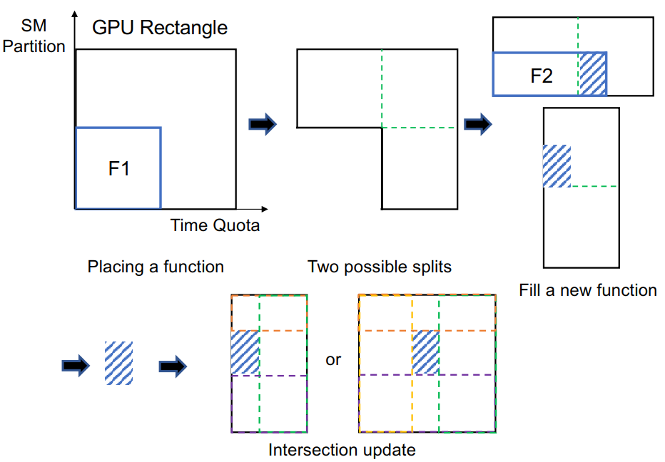
FaST-Scheduler
Node selection
Schedule function pods to enhance 2D GPU resource efficiency and mitigate resource fragmentation
Maximal rectangles algorithm
Rectangle best matching for node selection
Resource rectangle restructuring
Split
Intersection update
Redundant rectangle removing

Slide 24
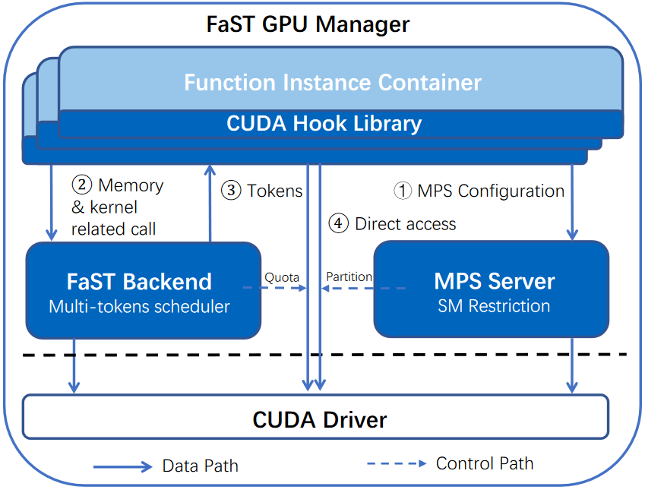
FaST-Manager
Spatio-Temporal GPU Sharing Manager
Limit, prioritize, and isolate GPU resource usage in both spatial-temporal dim
Goal：enable efficient sharing of GPUs among different pods
Frontend-Backend architecture
Initialize the corresponding SM partition in the
MPS server
Register the allocated time quota and memory
in the FaST Backend
Evaluates the request and determines whether
to dispatch the token
If the token is granted, start accessing CUDA
driver
Notes:
1. 前端是一个与推理函数运行在一个pod中容器负责接收GPU配置请求并劫持CUDA api请求

Slide 25
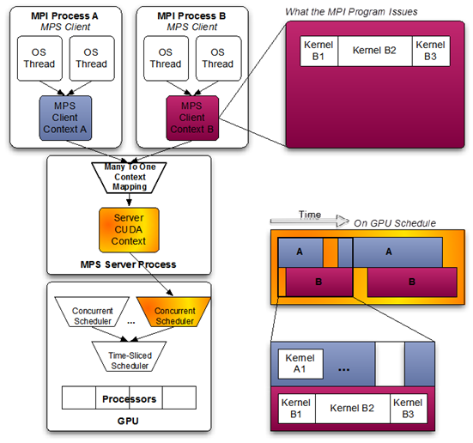
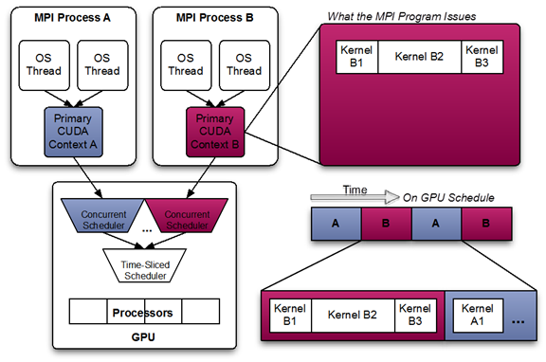
FaST-Manager
MPS-based Spatial Sharing Backend
MPS：process kernels concurrently, while provide performance isolation
SM
percent
Multi-processes without MPS
Multi-processes with MPS

Slide 26
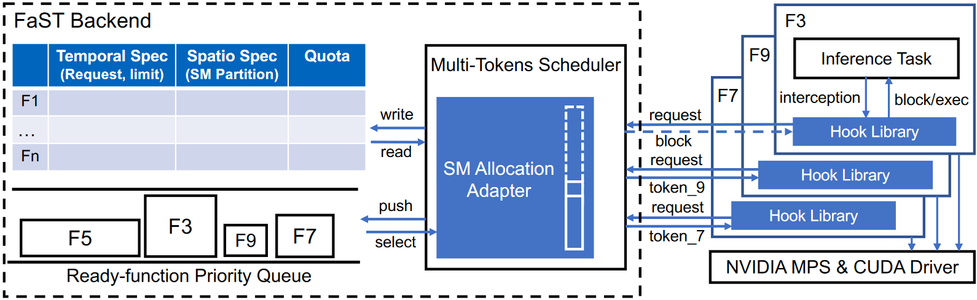
FaST-Manager
FaST Time Sharing Backend
Perform temporal GPU sharing with the consideration of the spatial sharing
Monitoring-scheduling mechanism：monitoring
Flexible and fine-grained CUDA time counting
The CUDA synchronization API is called at the end of the kernels execution

Slide 27
FaST-Manager
FaST Time Sharing Backend
Perform temporal GPU sharing with the consideration of the spatial sharing
Monitoring-scheduling mechanism：scheduling
Filtering：calculate the remaining time quotas of each pod（Q_{remain} > 0）
Candidate pod enqueuing： prioritizes scheduling pods with the largest timing missing gap
Token dispatching：return tokens until S_{SMs} + S_{running} > 100%

Slide 28
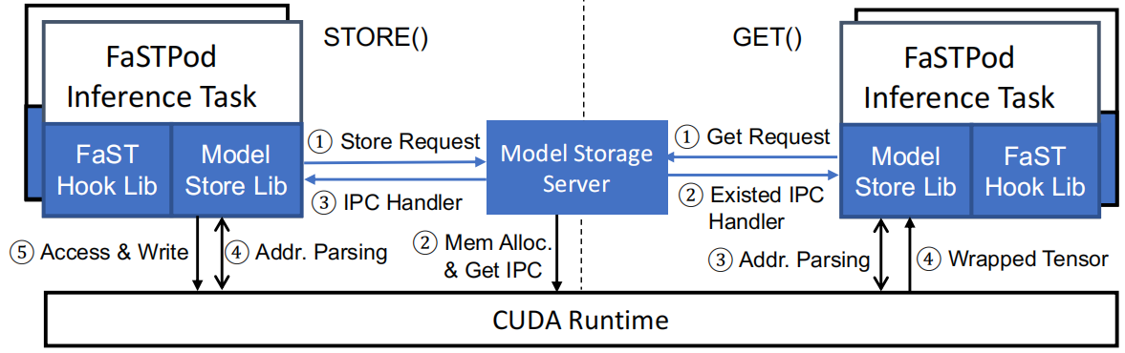
Model Sharing
Mitigate the memory contention
IPC-based model sharing mechanism
Model Store Lib and Model Storage Server

Slide 29
Outline
Current Progress
FaST-Gshare
MuxServe
Background
Design
Conclusion

Slide 30
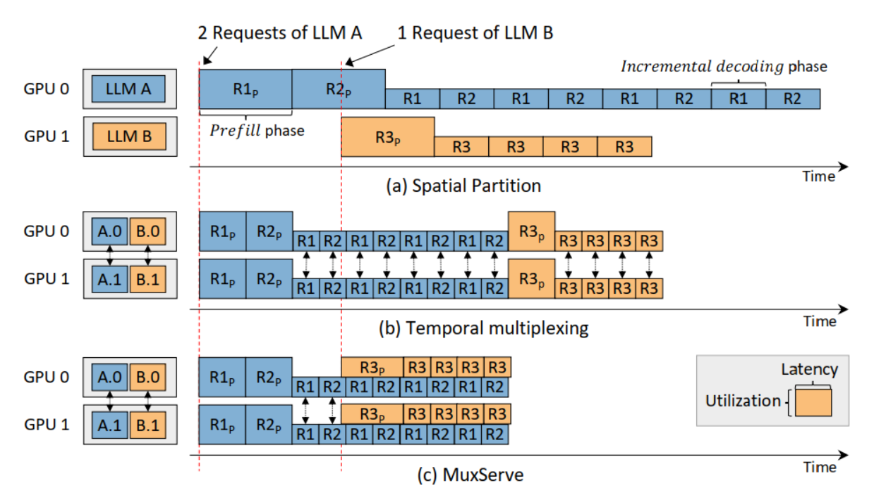
Under-utilization in GPU Sharing
Spatial sharing
Load imbalance due to careless model placing
Temporal sharing
Prefill: heavy compute/light memory
Decoding: light compute/heavy memory

Slide 31
Outline
Current Progress
FaST-Gshare
MuxServe
Background
Design
Conclusion

Slide 32
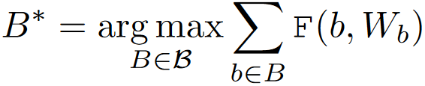
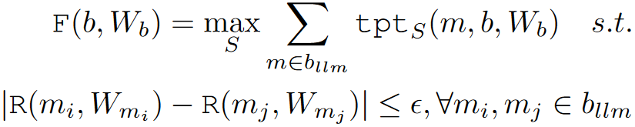
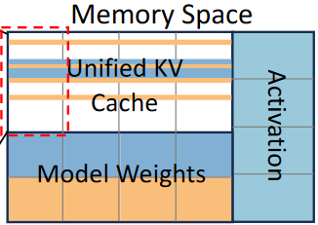
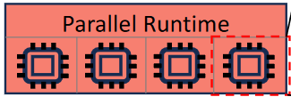
Overview on MuxServe’s Design
Design
Colocate LLMs considering their popularity
Colocate prefill or decoding jobs from different LLMs
Problem Formulation
Placement Algorithm
Adaptive Batch Scheduling
Resource
Manager

Slide 33
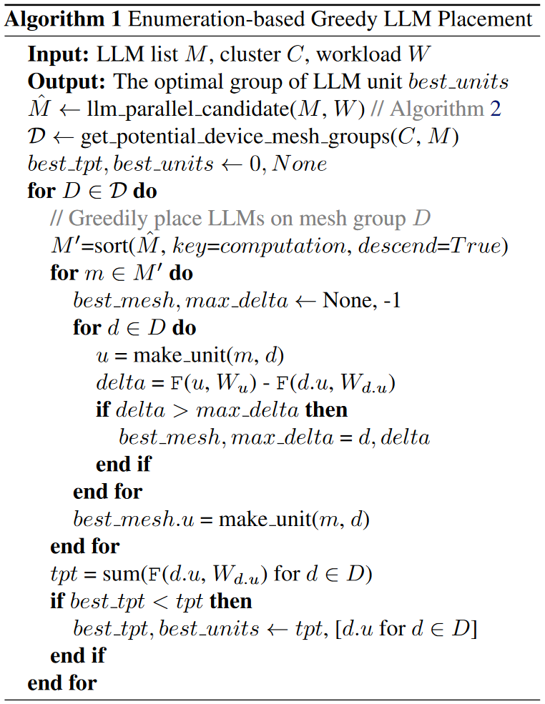
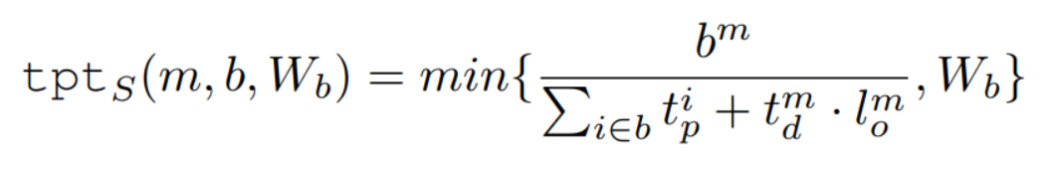
MuxServe – Multi-model Placement
Find the placement assuring best tpt.
Enumeration algorithm
Estimate each model’s possible resource candidates considering the workload
Enumerates all potential device mesh groups to find LLM units with the best tpt.
Throughput estimation
History traffic is used since it changes slowly
Pre-profiling would cost more in LLM serving than traditional DNNs

Slide 34
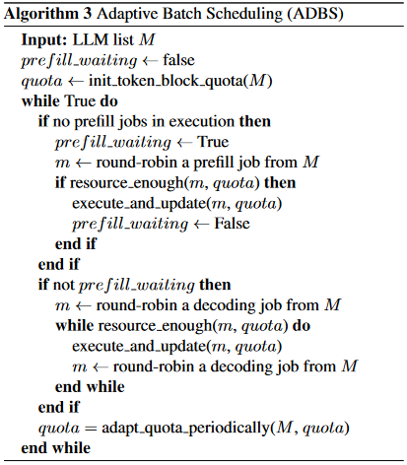
MuxServe – Intra-Unit Scheduling
Schedule within LLM units for best tpt.
Adaptive batch scheduling
Prioritizes prefill jobs and fills remaining resources with decoding jobs
Adapts the token block quota for each LLM periodically
Estimate the throughput of LLM m (again)

Slide 35
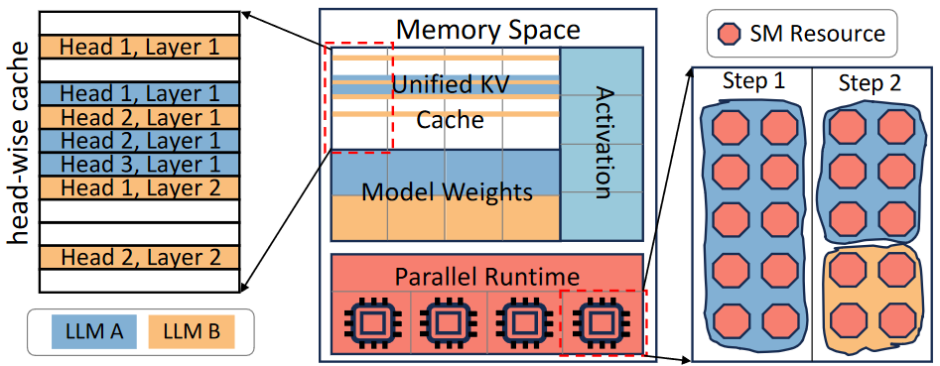
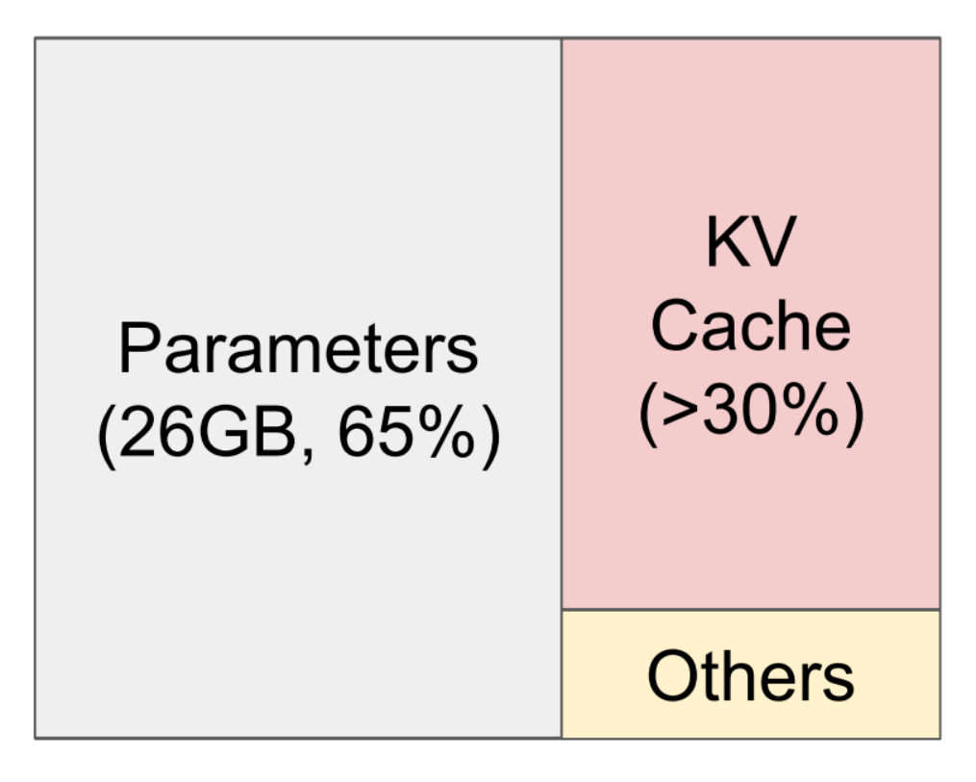
MuxServe -- Resource Manager
Computation resource
Assign SMs via MPS after scheduling
Memory resource – three parts
Unified head-wise KV cache
Single replica of LLM weights
Activation during runtime
Overview of GPU resource management
in an LLM unit
Memory consumption of LLMs from vLLM$\left[2\right]$
[1] MuxServe: Flexible Spatial-Temporal Multiplexing for Multiple LLM Serving. ICML’24
[2] Efficient Memory Management for Large Language Model Serving with PagedAttention. SOSP’23
Notes:
KV cache increases dynamically, and different LLMs posses varying sizes of KV cache due to differences in the number of attention heads, hidden layers, and hidden sizes.

Slide 36
Outline
Current Progress
FaST-Gshare
MuxServe
Conclusion

Slide 37
Conclusion
Profiler
Profile the function throughput and latency under various spatio-temporal GPU resource
Scheduler
Select resource config, perform the auto-scaling and node selection for function

Slide 38
Conclusion
Manager
Coordinate the spatial and temporal GPU resource sharing by limiting and isolating resources
Model sharing

Slide 39
Conclusion
complete workflow
transparent middleware -> easy to use
two-dimension vGPU abstraction

Slide 40
Fine-grained GPU Sharing
Temporal GPU sharing
vGPU
memory resource: spatial, hard limit
computing resource: temporal, elastic limit
vGPU1(0.4,0.6)
vGPU2(0.4,0.6)
vGPU3(0.2,0.2)
0
0.6T
T
1.4T
1.8T
2T
[1]GaiaGPU: Sharing GPUs in Container Clouds ISPA’18

Slide 41
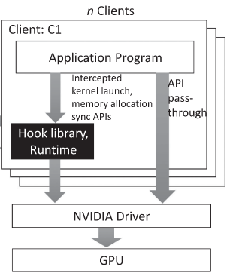
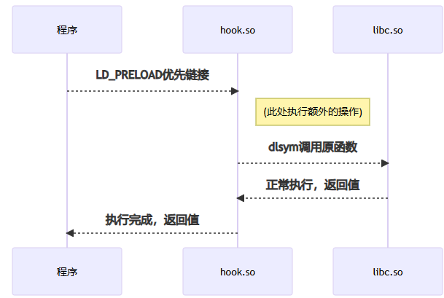
Fine-grained GPU Sharing
Temporal GPU sharing
Intercepting CUDA driver API
Linux LD_PRELOAD / LD_LIBRARY_PATH
memory-related APIs
computing resources-related APIs
device info-related APIs
[1]https://github.com/Bruce-Lee-LY/cuda_hook.git

Slide 42
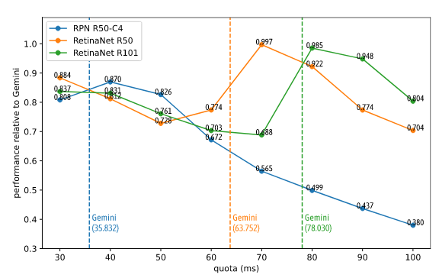
Fine-grained GPU Sharing
Temporal GPU sharing
vGPUs + CUDA APIs Intercepting
token: permission to execute containers on the GPU
time quota: the valid period of the token
fixed^{[1]}
dynamic^{[2]}
[1]KubeShare: A Framework to Manage GPUs as First-Class and Shared Resources in Container Cloud HPDC’20
[2]Gemini: Enabling Multi-Tenant GPU Sharing Based on Kernel Burst Estimation TCC’23

Slide 43
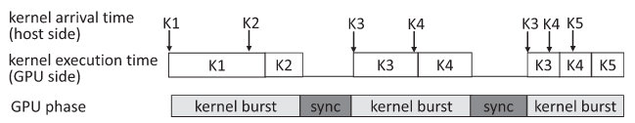
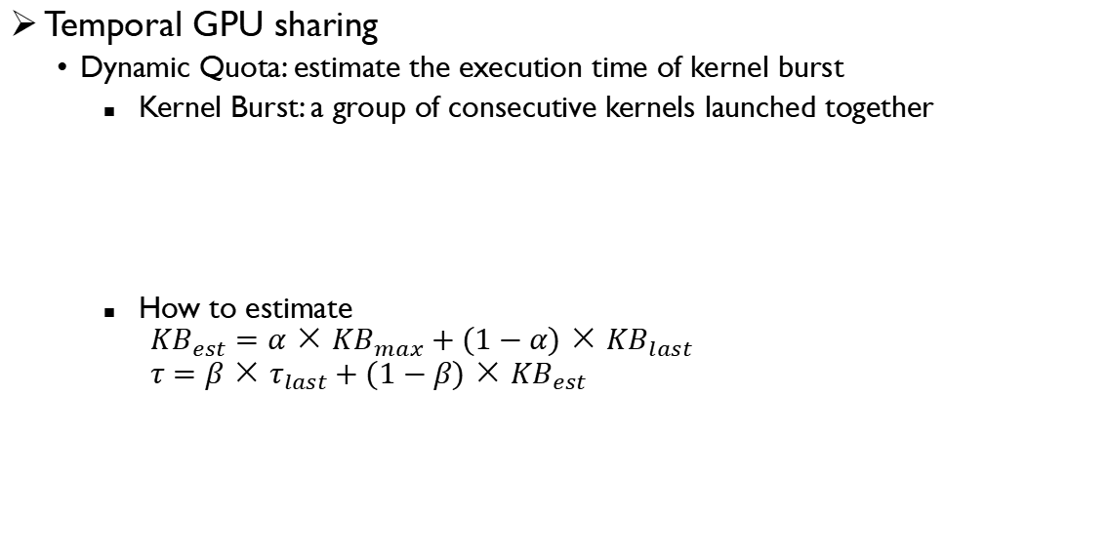
Fine-grained GPU Sharing
Temporal GPU sharing
Dynamic Quota: estimate the execution time of kernel burst
Kernel Burst: a group of consecutive kernels launched together
How to estimate
$${KB}_{est}=α×{KB}_{max}+(1−α)×{KB}_{last}$$
$$τ=β×τ_{last}+(1−β)×{KB}_{est}$$
[1]Gemini: Enabling Multi-Tenant GPU Sharing Based on Kernel Burst Estimation TCC’23

Slide 44
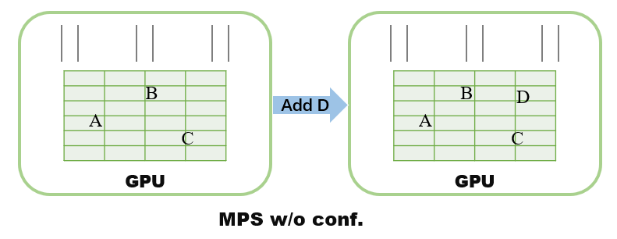
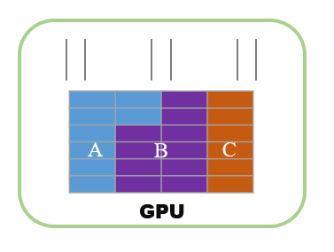
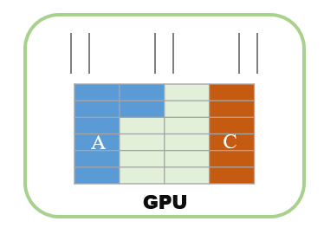
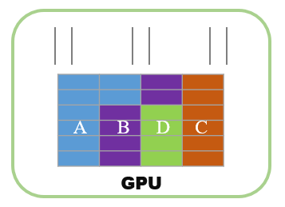

Fine-grained GPU Sharing
Spatial GPU sharing
New understanding of MPS
w/ or w/o resource configuration
Add D
A conflict between resource isolation and flexibility in MPS
[1] Fine-grained accelerator partitioning for Machine Learning and Scientific Computing in Function as a Service Platform. SC-W’ 23
[2] GSLICE: Controlled Spatial Sharing of GPUs for a Scalable Inference Platform. SoCC’20

Slide 45
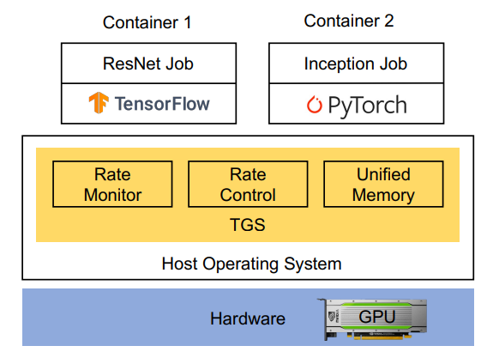
Fine-grained GPU Sharing
Dynamic spatial sharing in container clouds
Motivation
Low resource utilization in common practice
Nontransparent sharing resulting in refactoring
Design goals of TGS
Dynamic spatial sharing for high GPU utilization
OS-layer implementation to ensure transparency
[1] Transparent GPU Sharing in Container Clouds for Deep Learning Workloads. NSDI’23
Notes:
1. 低利用率、

Slide 46
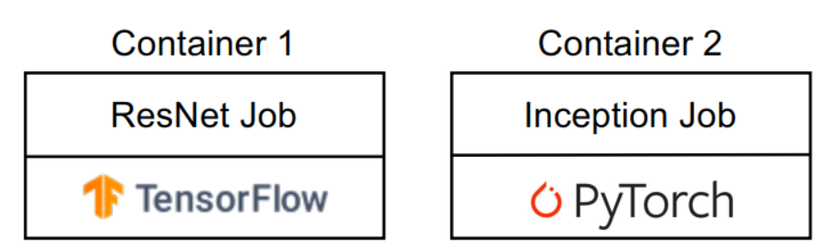
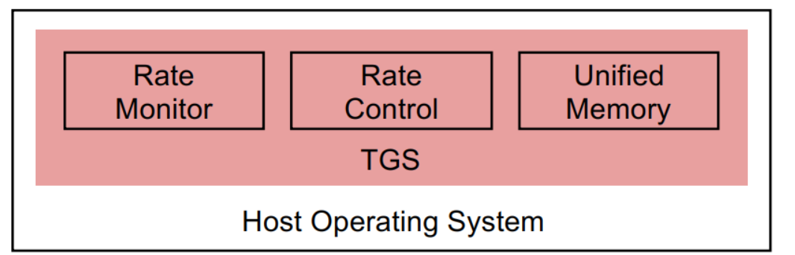



Fine-grained GPU Sharing
Dynamic spatial sharing
Performance monitoring
OS level: Application performance detection
E.g., kernel’s arrival rate, etc.
Hardware level: GPU counter API (DCGM)
Arrival rate monitoring
Kernel queue
[1] Transparent GPU Sharing in Container Clouds for Deep Learning Workloads. NSDI’23

Slide 47
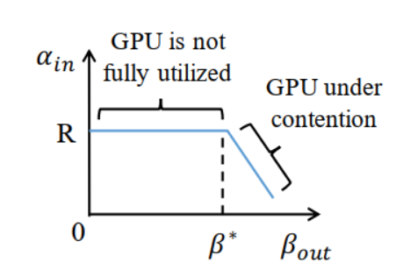
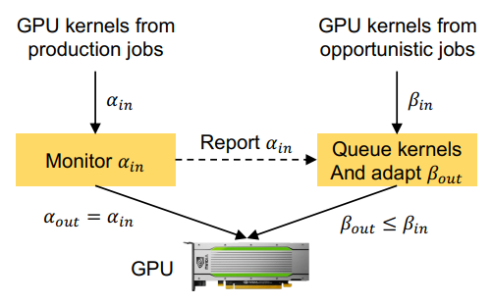
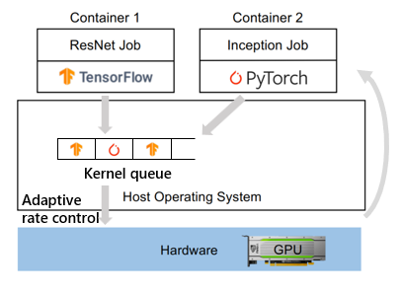
Fine-grained GPU Sharing
Dynamic spatial sharing
Performance monitoring
Dynamic resource adjustment
Launch rate control (by priority)
No direct GPU operations
Online profiling on inference tasks matters
[1] Transparent GPU Sharing in Container Clouds for Deep Learning Workloads. NSDI’23

Slide 48
Outline
Background
Architecture
Implementation
Evaluation

Slide 49
Experiment Setup
Testbed
1 master node: 60GB host memory
4 work nodes: each with a V100 (16GB GPU memory)
Cloud framework: Kubernetes v1.24.2
Benchmark
MLPerf benchmark by NVIDIA
ResNet, BERT, RNNT and GNMT
Transformer benchmark
ResNeXt and ViT_hug
Evaluate GPU resource usage with DCGM-Exporter and nvidia-smi

Slide 50
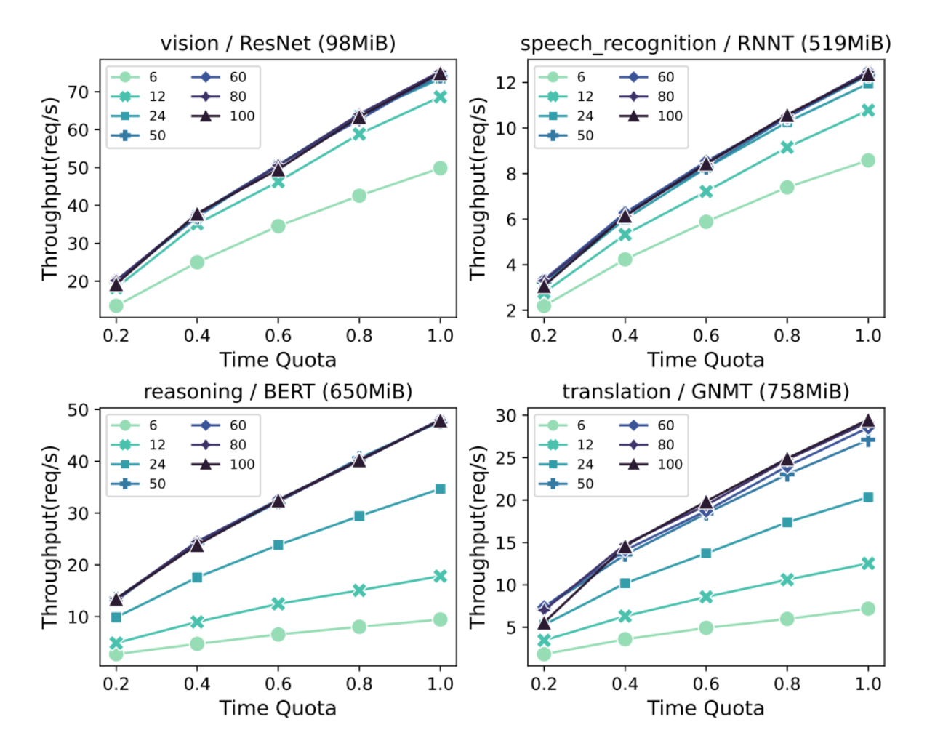
Profiling and Isolation
Profile isolated throughput of different models
Under different temporal and spatial resource
A model cannot fully occupy all SMs

Slide 51
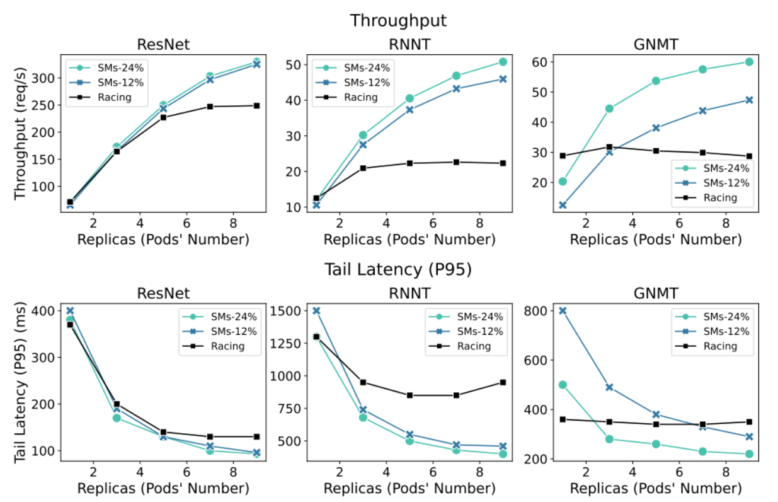
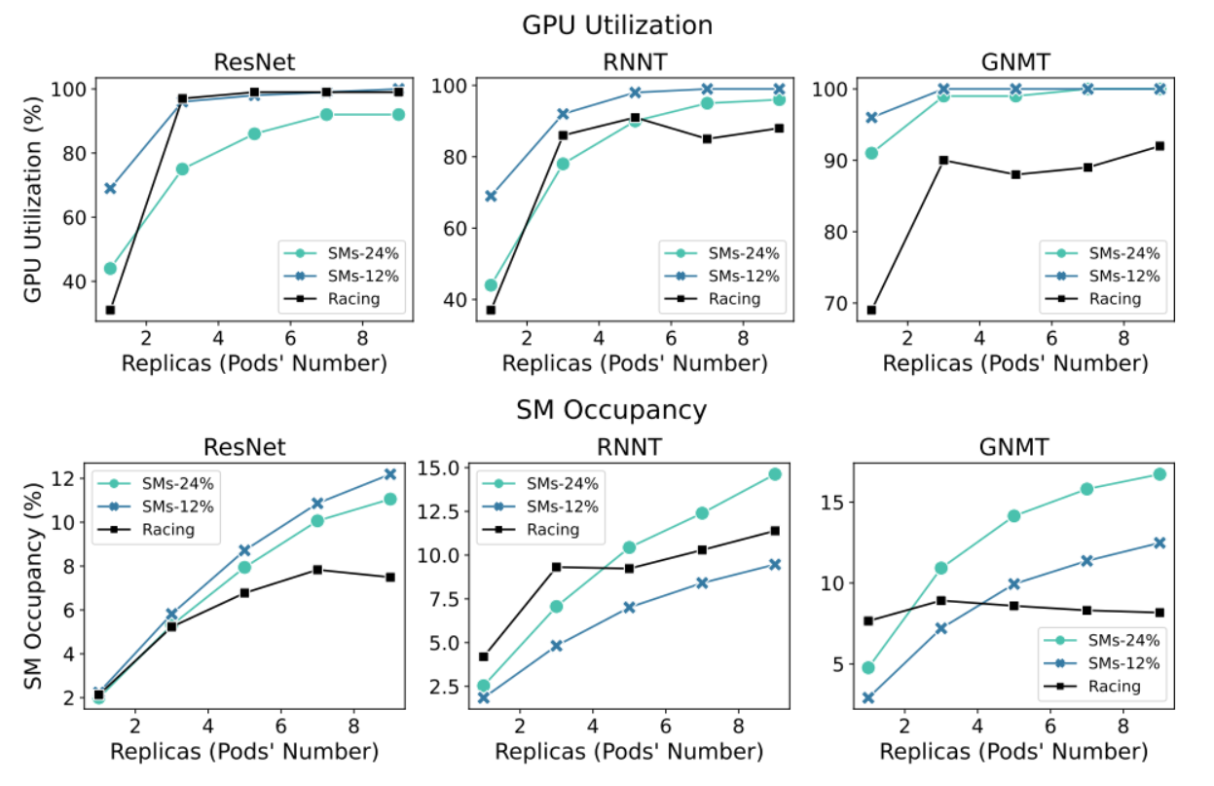
Spatial Sharing Performance Validation
Evaluate impact of different spatial sharing ratios
Throughput, tail latency, GPU util% and SM occupancy

Slide 52


Efficient FaST-Scheduler
Spatio-temporal sharing v.s. time sharing only
Scales 4 ResNet pods, 2 RNNT pods, 2 BERT pods among 4 GPUs
Results are obvious since compute resource isn’t saturated
Auto-scaling of function instances

Slide 53

Model Sharing
Memory footprint of multiple pods
Total memory footprint of a shard model
Sharing part + unique part * (# of pods) + sharing overhead * (# of pods)

Slide 54

Kernel execution --- CUDA stream
CUDA stream
A sequence of kernel functions that execute in issue-order on the GPU
CUDA stream is a concept within the scope of CUDA context
Multi-stream
Kernels from different streams can execute concurrently
Kernels from the same streams must execute sequentially

Slide 55
Inference Request
Control Plane
Data Plane
Request Scheduler
Dispatch
Inference Instances
GPU
CPU
Storage
Model Initiator
Initiate
New Instance
GPU
CPU
Storage
Model Storage
Load

